Slide 1
Monster Design
Introduction and Theory

Slide 2
Session 1 9-10,30 Goals
Introduce Enemy Design
Introduce AI Core Concepts
Introduce UE4 Tools

Slide 3
Introduction
Hi!
Who am I, my names Greg I lead the Computer Games Design award. You can find more about what I get up to here
https://www.artstation.com/gregpenninck
https://connect.unity.com/u/greg-penninck

Slide 4
Introduction
Why are you here?
Hopefully you;
Enjoy games design
Enjoy game engines
Have some experience with Blueprints in the Unreal Engine
Want to learn how to begin your journey into the world of Game AI
Enjoy memes.
How will this help your studies at 2nd year?
3D Games Design and Development expects you to work with the Unreal Engine.
Advanced 3D Games Engines and Scripting requires you to build AI systems.
Collaborative Games Development modules may require you to build AI.
But most importantly it’s JUST AWEEEEEEEEEEEEEESOME

Slide 5
Enemy Design
Why do we have enemies?
Challenge / Core experience
A wall in the way of the players goal
An excuse to utilise awesome mechanics to empower the player
Archetypes and player expectations
Story / Narrative
Mechanisms to deliver story
Well designed enemies can enhance the
Notes:
https://media.wizards.com/2016/dnd/downloads/5E_CharacterSheet_Fillable.pdf
http://dnd.wizards.com/articles/features/character_sheets

Slide 6
Enemy Design
How can we start designing enemies?
We need core gameplay mechanics that empower the player.
We need to think how enemies match / empower the player to react and use their mechanics.
Where could we start?

Slide 7
Activity
Fill out a DND character sheet, you have 5 minutes.
https://media.wizards.com/2016/dnd/downloads/5E_CharacterSheet_Fillable.pdf
http://dnd.wizards.com/articles/features/character_sheets
Look at the language, properties and features that you are expected to complete. How do you think this changes across game genres?

Slide 8
Enemy Design
Visually ? Thematically ? Mechanically?
For todays workshop we are not going to be worrying about visuals and thematics, we have a bunch of assets to use.
We are going to focus on the mechanics of player detection, enemy behaviours, debugging and play testing.

Slide 9
AI Core Concepts
Whilst this lecture is not a traditional AI theory lecture it’s important for us to discuss some key AI methods.
What are;
State Machines
Behaviour Trees
Path Finding
Navigation Meshes
Notes:
https://software.intel.com/en-us/articles/designing-artificial-intelligence-for-games-part-1
https://www.gamedev.net/articles/programming/artificial-intelligence/the-total-beginners-guide-to-game-ai-r4942/
https://www.gamasutra.com/view/news/269634/7_examples_of_game_AI_that_every_developer_should_study.php

Slide 10
AI Core Concepts
What do you think the 3 things any AI should be able to do are?
Detecting
Locate a thread, this could be the player a world stimulus.
Decision
Formulate a plan.
Actions
Act on that plan.

Slide 11
AI Core Concepts
Key difficulties;
We don’t have to model reality exactly.
We have to be mindful of how much knowledge AI have of the game “Domain Knowledge”.
We have to be mindful of our systems being design friendly.
We have to be mindful of our systems being performant.
We have to be mindful of our systems being consistent.
As we progress we should look to make our systems modular so that they may be reused.

Slide 12
UE4 :- AI Controllers + Characters
To setup AI in Unreal we need to begin with 2 classes.
AI Controllers :-
Enemies brain.
Response to stimulus, movement latency etc.
Characters :-
Physical representation in game.
Controls many of the Enemies statistics (Movement, VFX, Sounds, Collision, Visuals, Animations).
Notes:
https://docs.unrealengine.com/en-us/Gameplay/Framework/Controller/AIController

Slide 13
UE4 :- Behaviour Trees
Behaviour Trees are an AI technique common in many games today. UE4 has a great visual implementation which we are going to use.
Behaviour trees are a visual nodal system that allow us to model the AI decision making process in a modular flow based system.
We will be working with many types of nodes that will be help control the AI and make them behave…
Notes:
http://www.gamasutra.com/blogs/ChrisSimpson/20140717/221339/Behavior_trees_for_AI_How_they_work.php
https://docs.unrealengine.com/en-us/Engine/AI/BehaviorTrees/QuickStart

Slide 14
UE4 :- Behaviour Trees
Event Driven.
Success and Failure

Slide 15
UE4 :- Behaviour Trees & Blackboard Data
Blackboard Data are a special object that house important variables a Behaviour Tree may reference.
For example you may wish to store a variable that references to whether or not the AI can see the player or where the next way point is.
This Blackboard Data object exists outside of the Behaviour Tree nodes as a nice and easy means of variable storage and communication.

Slide 16
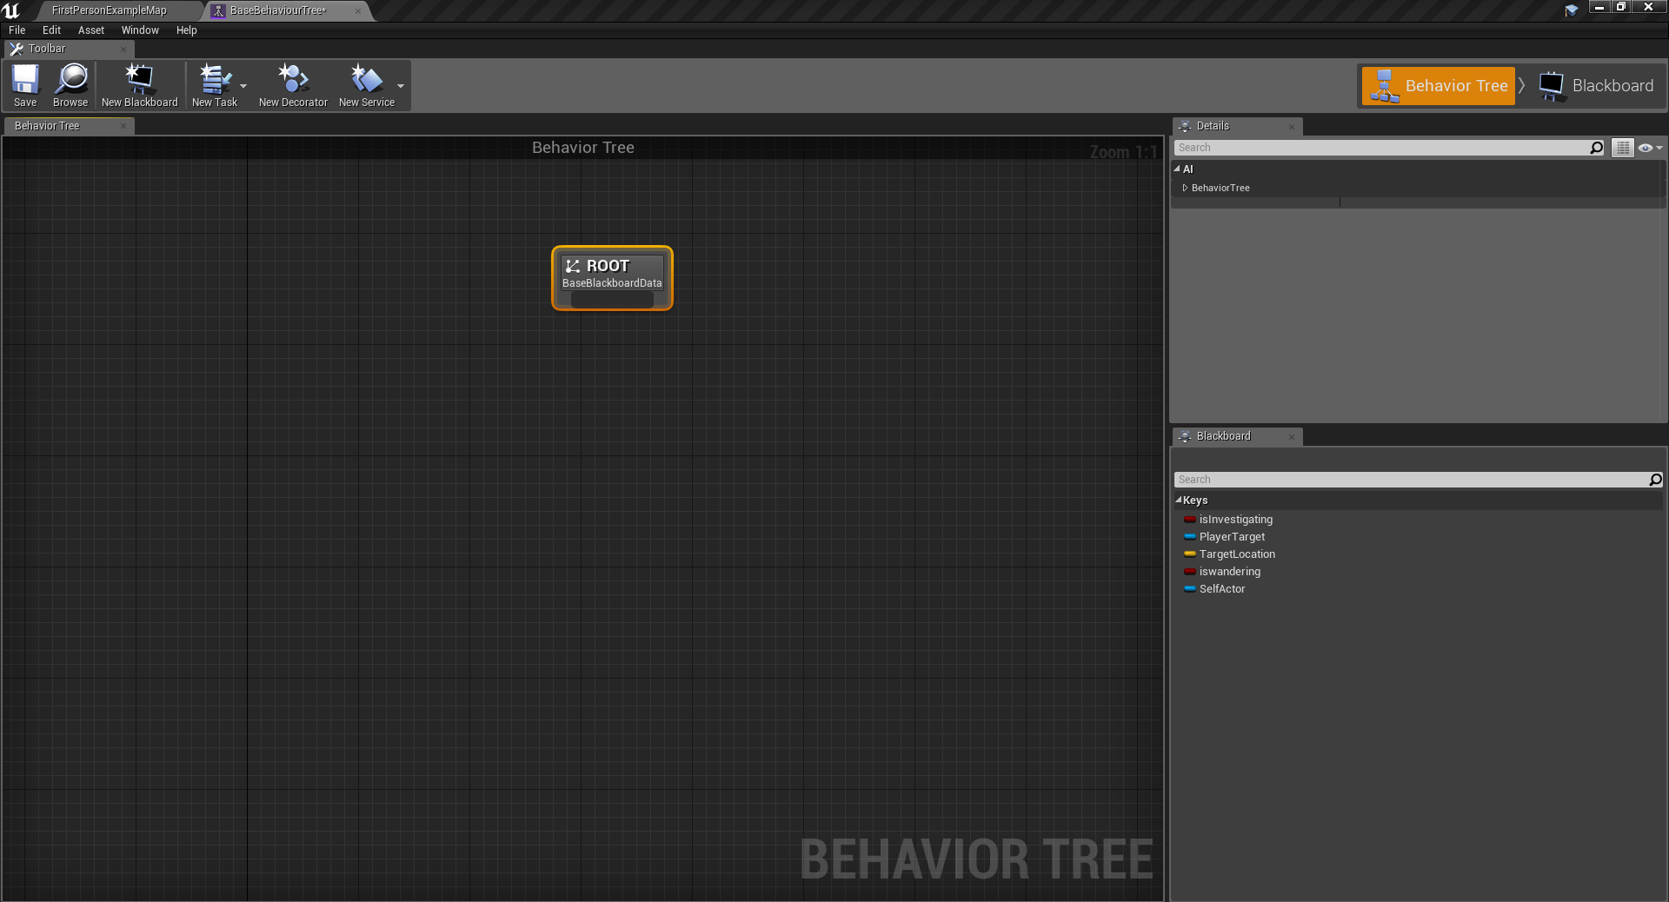
UE4 :- Behaviour Trees & Control
This is the UE4 Behaviour Tree editor.
The Graph in the middle will house the tree structure.
The Blackboard variables are listed on the lower right hand side. There is also a secondary interface to create new Blackboard keys here.

Slide 17
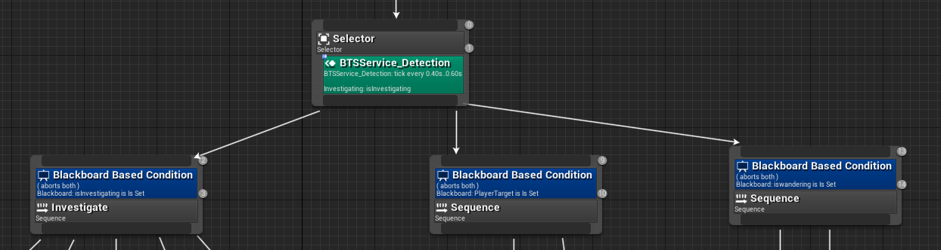
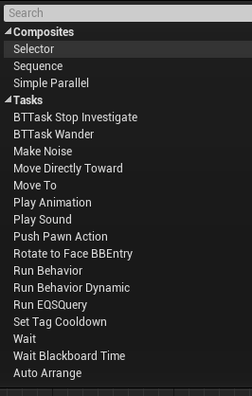
UE4 :- Behaviour Trees & Selectors
Behaviour Tree flow is controlled by a series of composite nodes. The first is a Selector Node. It will choose from a variety of subsequent nodes as they meet set conditions.
For example, run branch if we can see the player.

Slide 18
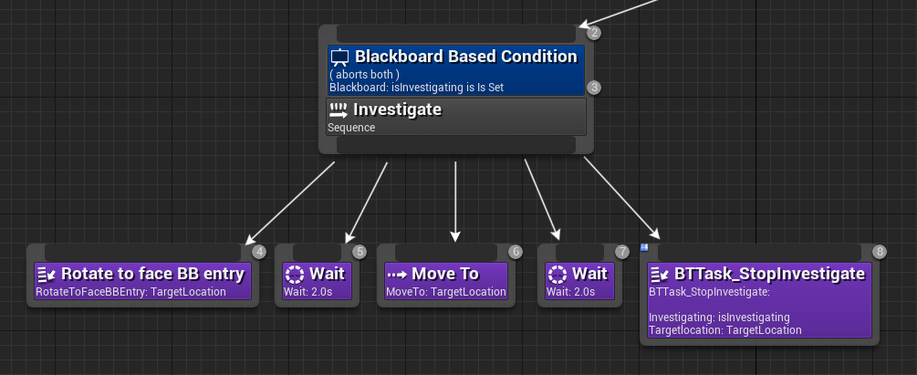
UE4 :- Behaviour Trees & Sequences
A Sequence node will play lower nodes in order from left to right.
The lower nodes are often Tasks which may carry out an animation / activity.

Slide 19
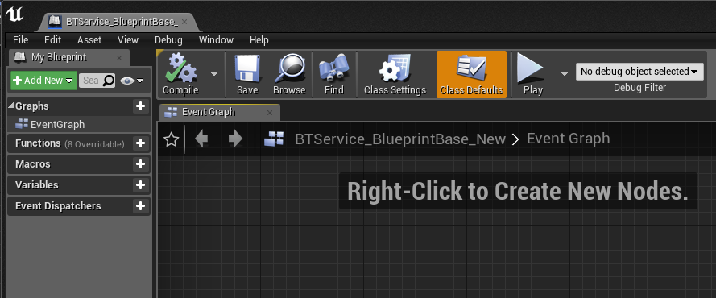
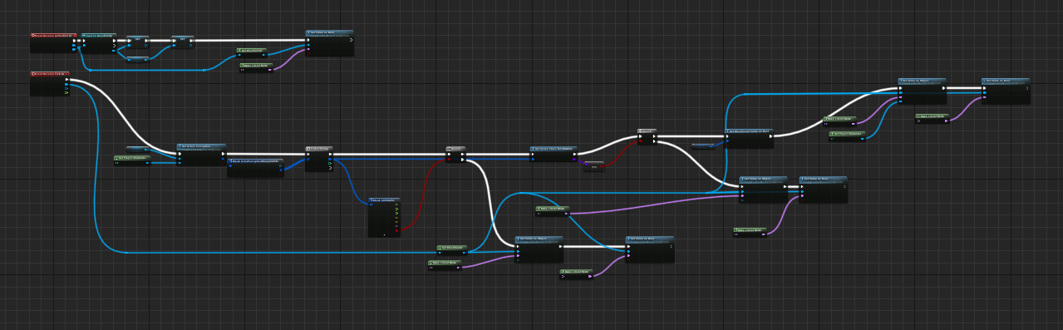
UE4 :- Behaviour Trees & Services
A Service node, will operate consistently whilst it is part of an activate flow of a graph.
Services are often used to carry out tests that require higher level of accuracy such as are we in range of a target to attack.

Slide 20
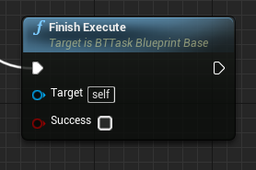
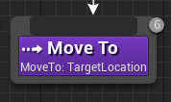
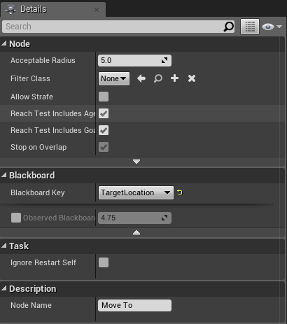
UE4 :- Behaviour Trees & Tasks
Tasks are a node that should return an execution success.
There are a number built into UE4 such as Waiting, Moving, Rotating etc.
I often expand these to carry out activities such as Playing an Animation, Launching a Special Attack or Trigging a Death Sequence.

Slide 21
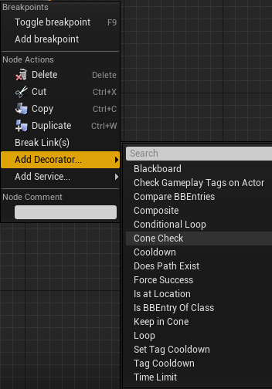
UE4 :- Behaviour Trees & Decorators
Decorators are ways to check conditions on branches of the tree.
A Decorator will allow you to run / abort sections of the tree.

Slide 22
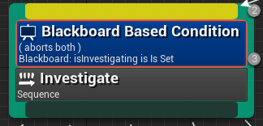
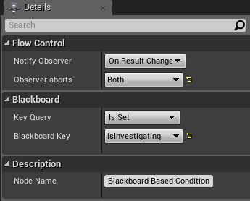
UE4 :- Behaviour Trees & Conditions
Blackboards are a common Decorator.
Here you can check one of the Behaviour Trees Blackboard variables and based on it’s Key Query you can abort or execute a tree Branch.
We will be using these later to check the Player Target and Locations.

Slide 23


Break time
Go stretch your legs / grab coffee etc.
We’ll start again in 30 minutes :-D

Slide 24
Good Watches
https://www.youtube.com/watch?v=nshHCycft4A
https://www.youtube.com/watch?v=tq-ULFuNyig
https://www.youtube.com/watch?v=zNJEvAGiw7w

